Slide 1



Telecommunication churn
Presented by Group 5

Slide 2

OUR TEAM
Akshaya
Anjali
Anuja
Pavan
Bandhavi
Pujitha

Slide 3

Introduction
The telecommunications industry is highly competitive, with customers often switching providers, causing high churn. Customer churn is the loss of clients who stop using a company’s services. This project aims to analyze customer data and usage patterns to predict churn using data analytics and machine learning. Predictive insights can help telecom companies improve services, offer personalized plans, and enhance customer satisfaction, reducing churn and boosting revenue.

Slide 4


Business Objective
Customer churn is a major problem for telecom companies. Their annual churn rates are often higher than 10%.
The goal of this project is to model churn probability conditioned on customer features and identify key drivers behind customer attrition.

Slide 5

Dataset Overview
• Dataset contains information about telecom customers.
• Each record represents a customer with multiple attributes such as:
- State, Account Length, International Plan, Voice Mail Plan
- Call Minutes and Charges (Day, Evening, Night, International)
- Customer Service Calls, Churn (Yes/No)

Slide 6
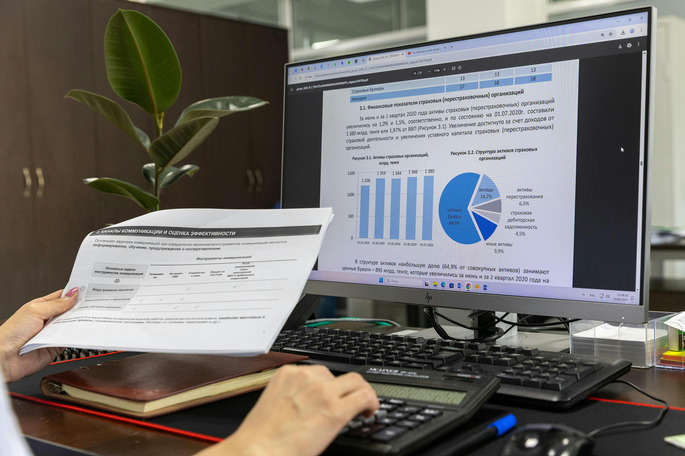
Exploratory Data Analysis (EDA)
• Checked missing values and outliers.
• Visualized churn distribution and plan-wise customer segmentation.
• Observations:
- Customers with international plans have higher churn.
- Frequent customer service calls often lead to churn.
- Long account duration customers are less likely to churn.

Slide 7
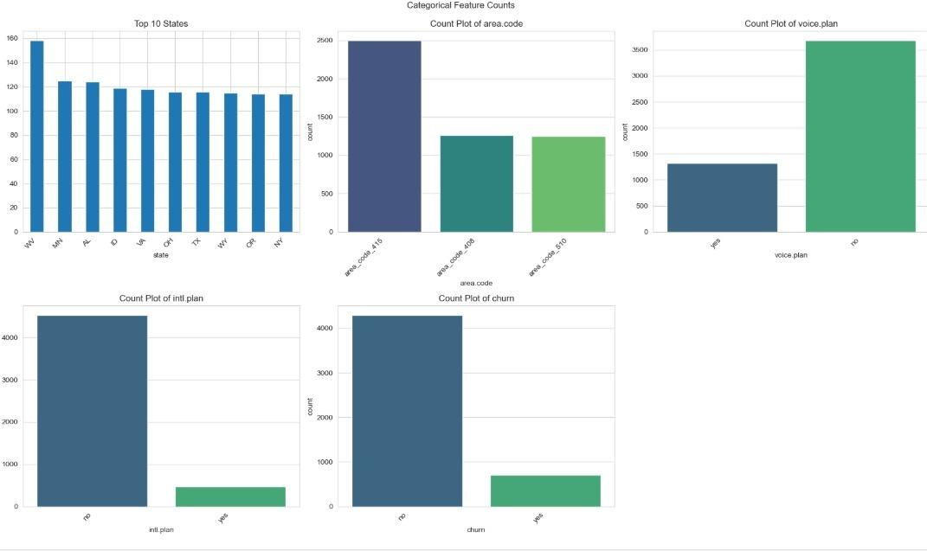
Categorical Data Analysis :-
This chart shows the distribution of key telecom features: most customers are from area code 415, and majority don’t have voice or international plans. The churn rate is low, with most customers staying with the company.

Slide 8
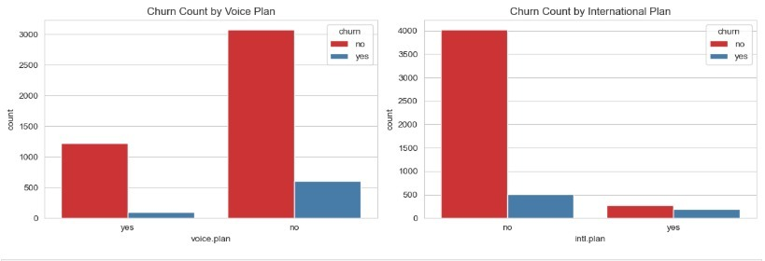
Churn Analysis by Plans
These charts show how churn relates to customer plans:
Customers without a voice plan have a higher churn count.
Customers without an international plan also churn more.
This indicates that plan types may influence customer retention.

Slide 9
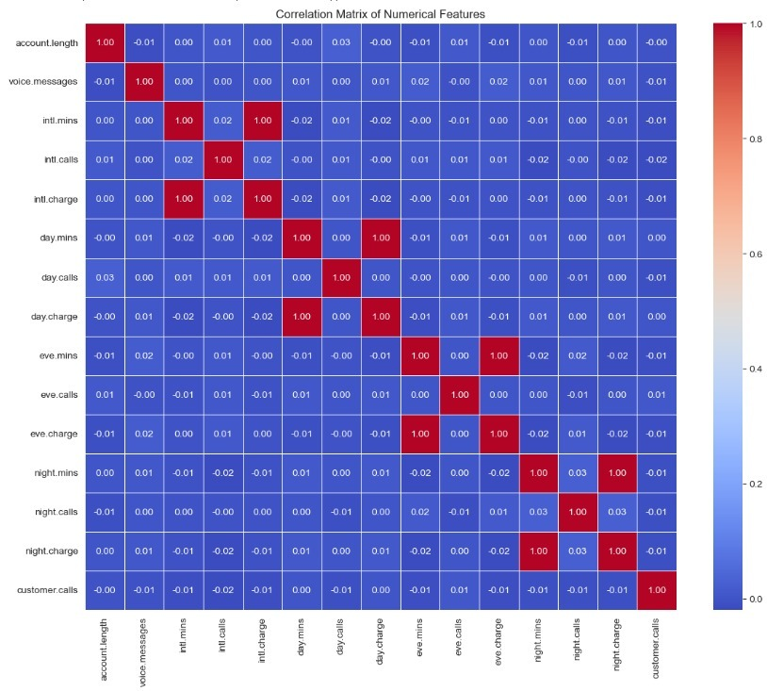
Correlation Matrix Analysis
This heatmap shows the correlation between numerical features in the telecom dataset.
Strong correlations are seen between minutes and charges .
Other features show very low correlation, indicating minimal linear relationships.
Helps identify which variables are related and useful for churn prediction.

Slide 10

Feature Engineering
• Converted (Label Encoder)categorical variables (Yes/No) into numerical format.
• Created new features like total_call_charge, total_minutes.
• Normalized (Standard Scaler)numeric columns for better model performance.
• Split dataset into 80% training and 20% testing sets.

Slide 11

Model Building
• Applied multiple classification algorithms:
- Logistic Regression
- Decision Tree Classifier
- Random Forest Classifier
- XGBoost
• Used GridSearchCV for hyperparameter tuning.
• Evaluated models using accuracy, precision, recall, F1-score, and ROC-AUC.

Slide 12

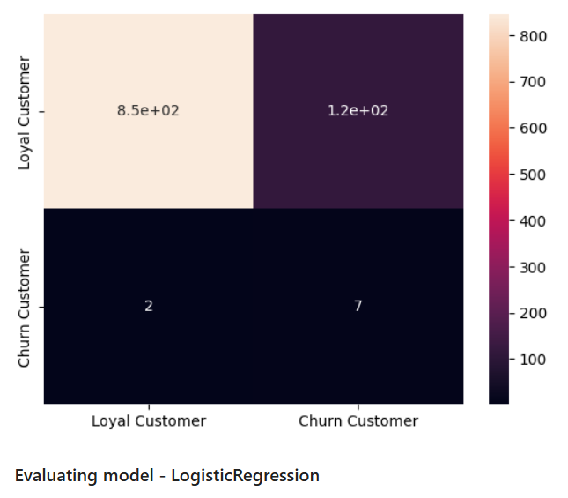
Logistic Regression
The model has a high overall accuracy (87.5%).
It is very good at identifying actual churners (Recall: 77.8%), which is critical for a churn model.
It made very few False Negative errors (2), meaning almost all actual churners were flagged.

Slide 13
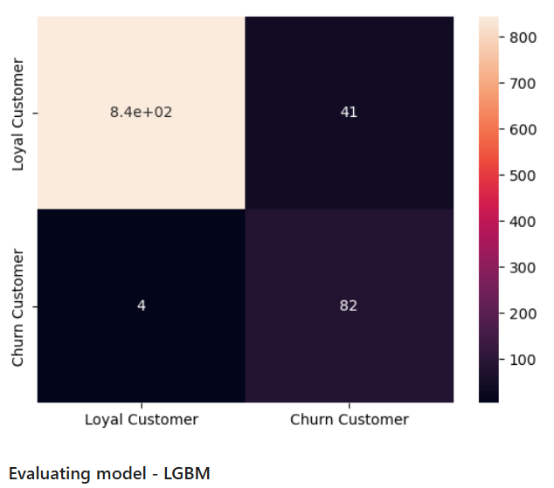
LGBM
The LGBM model shows significantly improved overall accuracy (95.3%).
It is outstanding at identifying actual churners (Recall: 95.3%). This means we are effectively targeting almost all at-risk customers.
It made very few False Negative errors (4), minimizing the loss of actual churners.

Slide 14

Model Evaluation
• Gradient Boosting (LGBM)performed the best with highest accuracy (~92%).
• Confusion Matrix shows balanced classification.
• ROC-AUC score indicates strong discrimination between churn and loyal customers.

Slide 15

Deployment
• Final model deployed using Flask web framework.
• Web app allows user to input customer data and predict churn probability.
• User Interface built with HTML, CSS, and Python backend.
• Hosting planned on Streamlit for easy access.

Slide 16
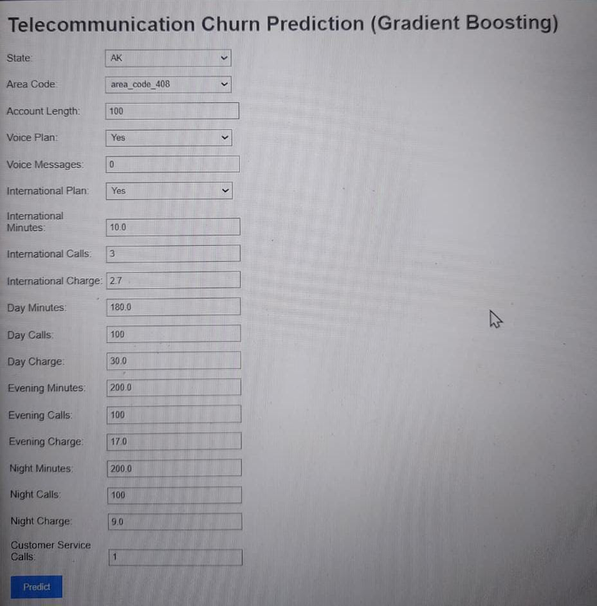
Result
This interface demonstrates how the Gradient Boosting Model is deployed for day-to-day use.
Analysts input key customer details (e.g., International Plan status, Call Minutes) into the system.
Clicking "Predict" instantly identifies a customer's churn risk, enabling proactive intervention to save the account.

Slide 17
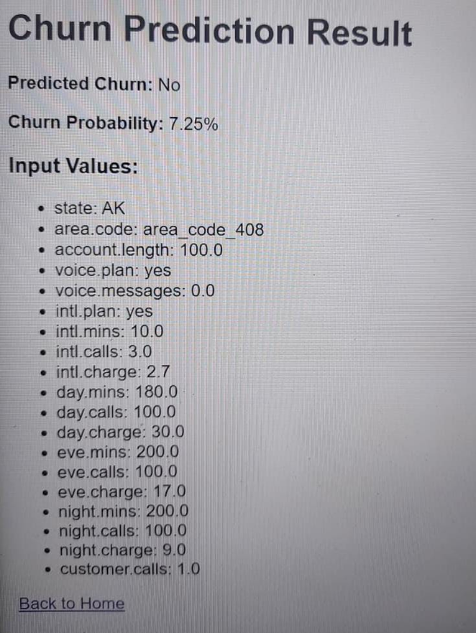
Prediction: For the input customer, the model predicts "No Churn".
Confidence: The specific Churn Probability is only 7.25%.
Actionable Insight: Since the churn risk is very low, the company does not need to intervene with this customer, saving resources for those who are at higher risk.

Slide 18
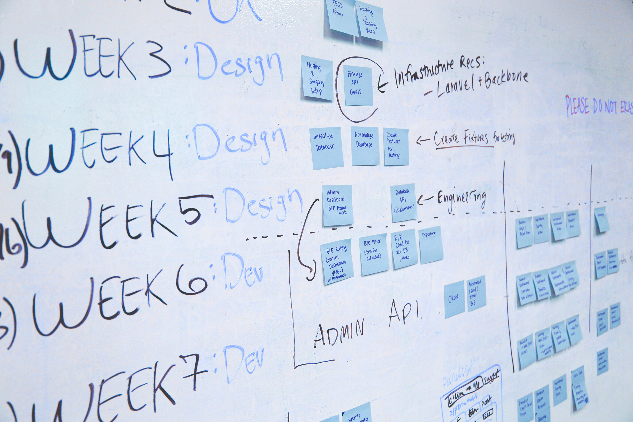

Project Timeline
• Kickoff & Business Discussion – 26th Sept
• EDA & Feature Engineering – 3rd Oct
• Model Building & Evaluation – 10th Oct
• Deployment – 17th Oct
• Final Presentation – 24th Oct

Slide 19


Conclusion and Future Work
• Key Findings:
- High customer service calls and international plans drive churn.
- Random Forest model achieved best accuracy.
• Future Work:
- Improve interpretability using SHAP values.
- Test with real-time streaming data.
- Deploy on cloud with continuous monitoring.

Slide 20
Thank You

